Slide 1
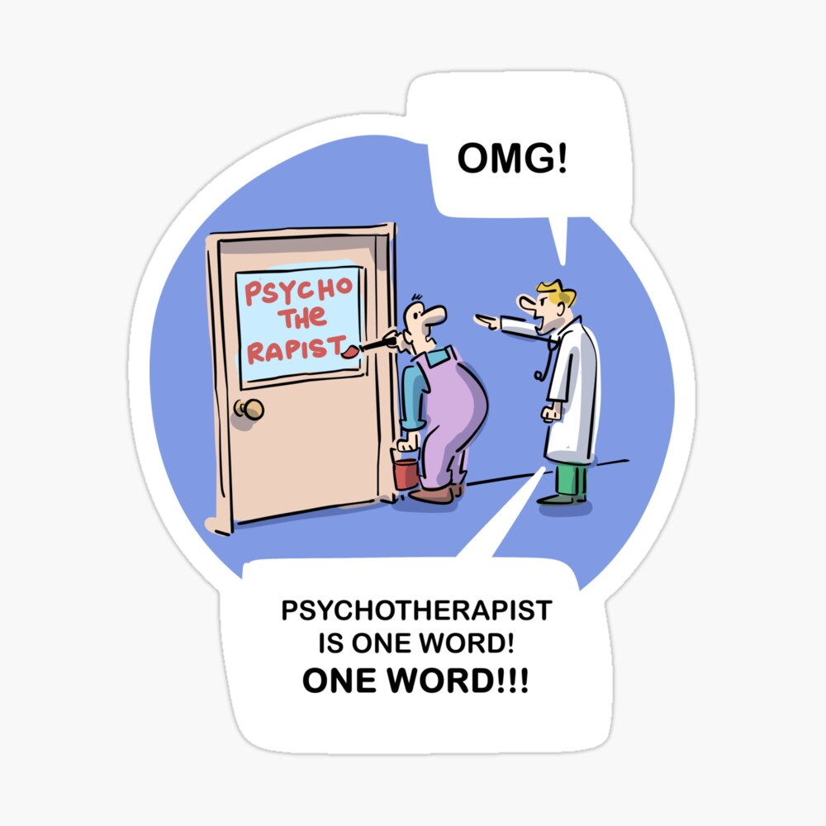
Telling it like it isn’t
Intersectionality between
violence and language
in context

Slide 2
A critical analysis of language
The problem of language is inextricably linked to the problem of violence
A critical analysis of language is not merely a semantic exercise or ‘perspectives’ view
There are real life implications for how people are regarded and how language is used puts them there
Four discursive operations of language
Language of effects and impacts vs responses and resistance

Slide 3
(Example 1) An account of sexualised violence
He followed her down the footpath. He sped up to catch her. He grabbed her by the shoulders and threw her to the ground. He overpowered her and dragged her into the bushes. He held a rock over her head and threatened to kill her if she screamed. He called her degrading names. He kissed her on the mouth. He tried to undo her belt. He grabbed at her pant legs to pull them off. He overpowered her and vaginally raped her.

Slide 4
Four Discursive Operations of Language To Benefit Perpetrators & the Status Quo
Conceals Violence
Blames, Pathologizes Victim
Obscures Perpetrator Responsibility
Conceals Resistance

Slide 5
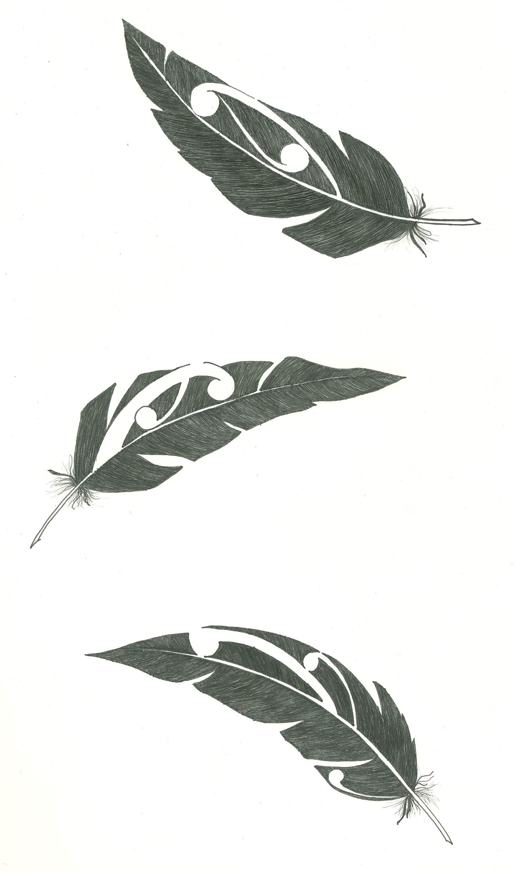
What is resistance?
The Scope of Resistance – Not a Definition
“Any mental or behavioral act through which a person attempts to expose, withstand, repel, stop, prevent, abstain from, strive against, impede, refuse to comply with, or oppose any form of violence or oppression (including any type of disrespect), or the conditions that make such acts possible, may be understood as a form of resistance” (Wade, 1997).
Wade, A. (1997). Small acts of living: Everyday resistance to violence and other forms of Oppression, (p. 25). Journal of Contemporary Family Therapy, 19.

Slide 6
Second account of sexualized assault
(Example 2) An account of sexualised violence
He followed her down the footpath. She sped up. He sped up to catch her. She moved to the side. He grabbed her by the shoulders and threw her to the ground. She rolled on the ground to get away. He dragged her toward the bushes. She grabbed the roots of a tree so he couldn’t drag her into the bushes. He overpowered her and dragged her into the bushes. She started to scream. He held a rock over her head and threatened to kill her if she screamed. She stopped screaming. He called her degrading names. She said, “You don’t want to do this. You don’t want to hurt me.” He forced his mouth onto her face. She averted her face. He tried to undo her belt. She stuck out her stomach so that he could not undo her belt. He grabbed at her pant legs to pull them off. She crossed her ankles so that he could not pull off her pants. He overpowered her and vaginally raped her. She went to limp to avoid injury and went elsewhere in her mind.

Slide 7
Reversing the Four Discursive Operations of Language The Language of Resistance: Truth telling
Reveal the Violence & Oppression
Contest
The Blaming of
Victims
Clarify
Responsibility
Clarify Resistance
Notes:
The point here is that we refer to violence as trauma… this hiding people’s truth, people’s histories and refusing to acknowledge that the harm was done by someone… a perpetrator… If someone is not held accountable, it is more likely that the victim will suffer through self-blame

Slide 8
False Descriptions and Social Responses
Negative social responses are built on false and prejudicial descriptions.
Research shows that violent crimes, victims, offenders are often misrepresented in criminal justice, media, mental health, and so on.
Although victims invariably respond and resist, they are often portrayed as passive or only as affected or impacted.
Although violence is deliberate, offenders are often portrayed as out of control, helpless victims of their biology or emotions.
And, although violence is unilateral, it is often portrayed as mutual.

Slide 9
On 5 November 1881, about 1600 volunteers and Constabulary Field Force troops marched on Parihaka. Several thousand Māori sat quietly on the marae as singing children greeted the force led by Native Minister John Bryce.
A Whanganui farmer had fought in the campaign against Tītokowaru and viewed Parihaka as a ‘headquarters of fanaticism and disaffection’. Bryce ordered the arrest of Parihaka’s leaders, the destruction of much of the village and the dispersal of most of its inhabitants. Many women were raped by troops, with some bearing children as a result.
Pressmen, officially banned from the scene by Bryce, were ambivalent about the government’s actions, but most colonists approved of them. The government managed to delay for several years the publication in New Zealand of the official documents relating to these events.
(“Invasion of pacifist settlement Parihaka”; nzhistory.govt.nz, 2022)

Slide 10
Reversing the Four Discursive Operations of Language The Language of Resistance: Truth telling
Reveal the Violence & Oppression
Contest
The Blaming of
Victims
Clarify
Responsibility
Clarify Resistance

Slide 11
On 5 November 1881, about 1600 volunteers and Constabulary Field Force troops marched on Parihaka. They were asked to leave their weapons outside the pā. Several thousand Māori refused to use violence and sat quietly on the marae as singing children greeted the force led by Native Minister John Bryce. This was a strategic effort to restore peace and uphold the mana of the tamariki who had an important role in their tribal resistance.
A Whanganui farmer had fought in the campaign against Tītokowaru and viewed Parihaka as a ‘headquarters of fanaticism and disaffection’. Bryce ordered the arrest of Parihaka’s leaders. The leaders asked the soldiers not to hurt their wāhine and tamariki, and not to destroy their remaining food crops.
The soldiers destroyed much of the village and saw to the dispersal of most of its inhabitants. The Māori men still refused to use violence and willingly surrendered peacefully to protect their wāhine and tamariki from further violence. Many women were raped by troops, with some bearing children as a result. Pressmen, officially banned from the scene by Bryce, were ambivalent about the government’s actions, but most colonists approved of them. Māori appealed for the release of Tohu and Te Whiti. The government introduced the “Māori Prisoner’s Act 1881” which meant Māori could be imprisoned without trial. The government managed to delay for several years the publication in New Zealand of the official documents relating to these events.

Slide 12
How we use language when we talk about violence is important... “Telling it like it isn’t” often uses language that relies on juxtapositions, superfluous obfuscation and oxymorons
... irony intended!

Slide 13
A Canadian genius once said… If you hit someone with a frying pan… you don’t call it cooking

Slide 14
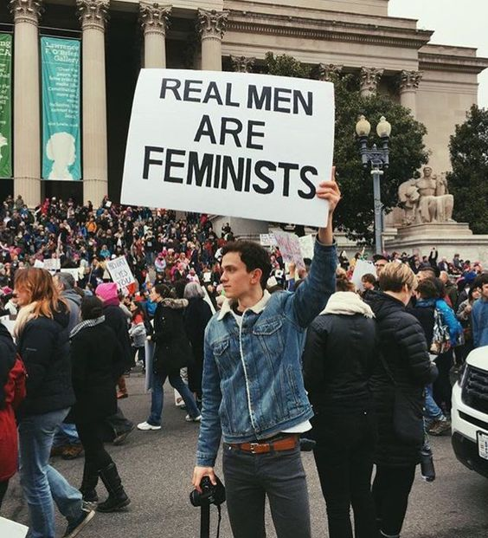
So… you don’t attack someone with your genitals, on theirs, and call it sex
Yet sadly these constructions are commonplace in public and professional discourse (especially in clinical
and legal settings)

Slide 15
The Language of Impacts & Effects vs the Language of Resistance & Responses

Slide 16
Example:
What happens when....
Don drops a hot cup of coffee on the floor…
impact?
effect?
resistance?
response?
Don throws a cup at the window…
Don gets drunk and throw a cup at a person…

Slide 17
So tell it like it is, not like it isn’t –
Stop nouning and start verbing

